Slide 1
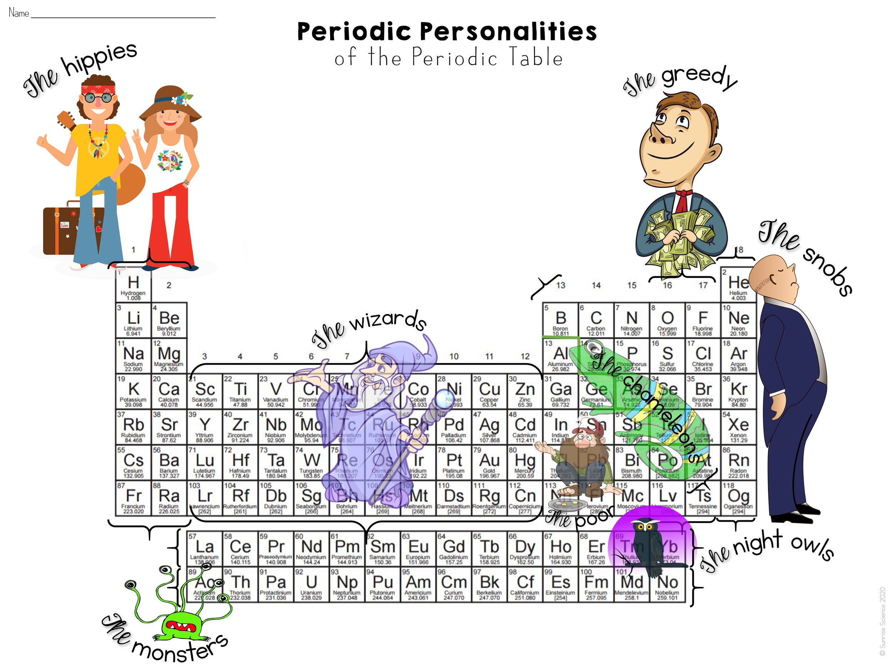

Slide 2
Families | Analogy | Personality
Alkali Metals and Alkaline Earth Metals |  | Peace & Love, Man
Transition Metals |  | Oooh, Aaah, Magic!
Poor Metals |  | Spare Change?
Metalloids |  | Masters of Disguise
© Sunrise Science 2020

Slide 3
Families | Analogy | Personality
Oxygen Group and Halogens |  | Gimme, Gimme, Gimme!
Noble Gases |  | I Want Nothing to Do with It!
Lanthanides |  | I Don’t Mind the Dark!
Actinides |  | Raarrrrr!
© Sunrise Science 2020

